Slide 1

Understanding Geopolitical factors and Covid-19 data
Eliot Cleveland
Gina Freed
Marc Leslie

Slide 2





Research – Our Higher Calling
Do GDP, HDI, CPI or Population Density lead to higher incidence of COVID cases or deaths?
This Photo by Unknown Author is licensed under CC BY-NC

Slide 3
Dataset = OWID + CPI
OWID data combines various datasets with real time reporting of COVID data (as of 4/30/21)
Corruption Perception Index in an independent factor that is reported annually

Slide 4
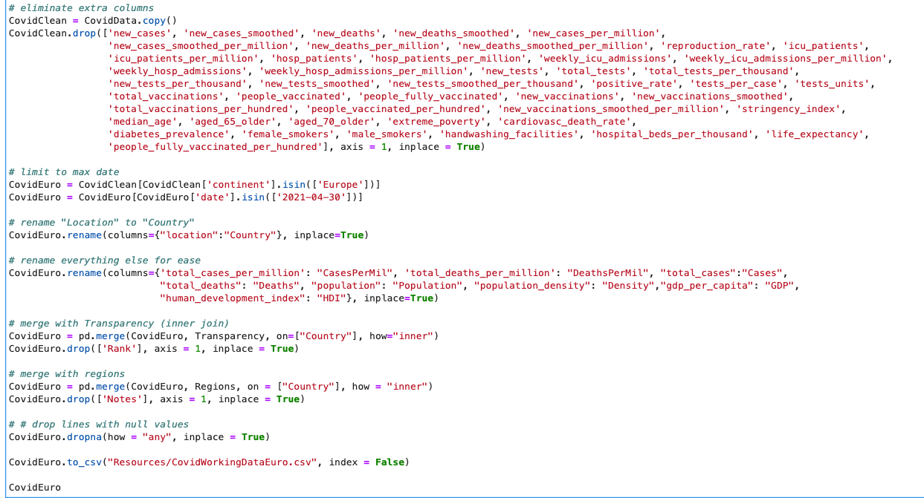
Data clean up
1) Pull in the csv file with 85580 records across 60 columns. Everything we tried to look at was general and murky.
2) Cut the down the data. We limited to the continent of Europe as of 4/30/2021 and were left with 48 records with 12 columns.
3) Renamed lots of fields because things like “total_deaths_per_million” were going to be horrible to query.
4) Merged via inner joins to add in corruption perception index and separate Europe into four regions.
6) Charts were throwing out errors, so we removed records with N/A values and were left with 40 records and 14 columns to work with.

Slide 5
Data exploration
(The things didn’t work)

Slide 6
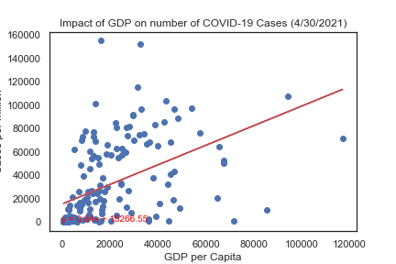
Regression – Global GDP
Notes:
Screen shot a better image

Slide 7
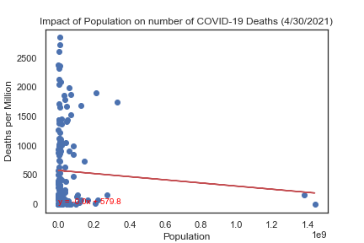
Regression – Global Population

Slide 8
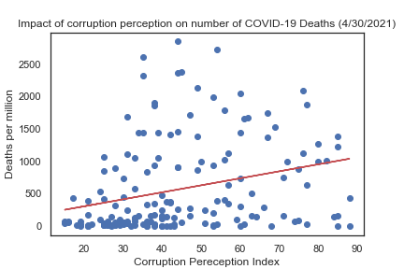
Regression – Global Transparency

Slide 9
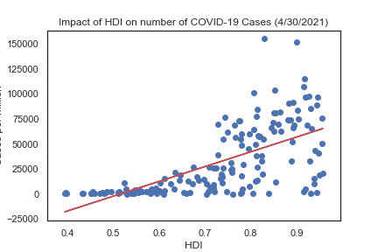
Regression – Global HDI (More Correlated)

Slide 10
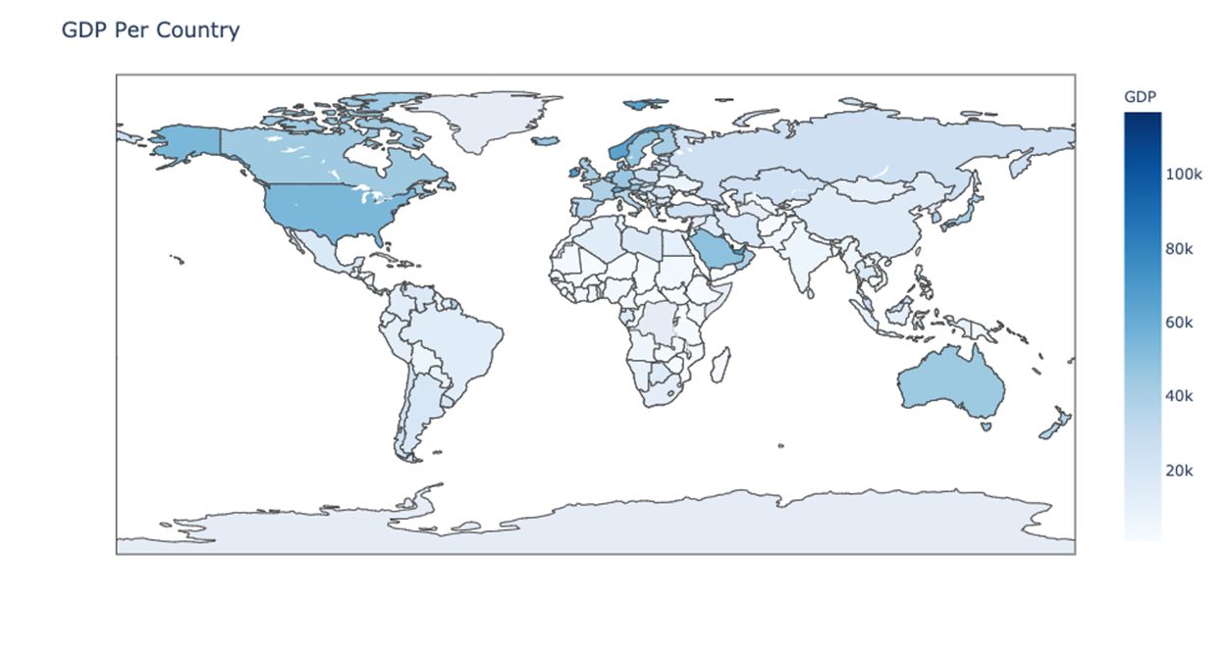
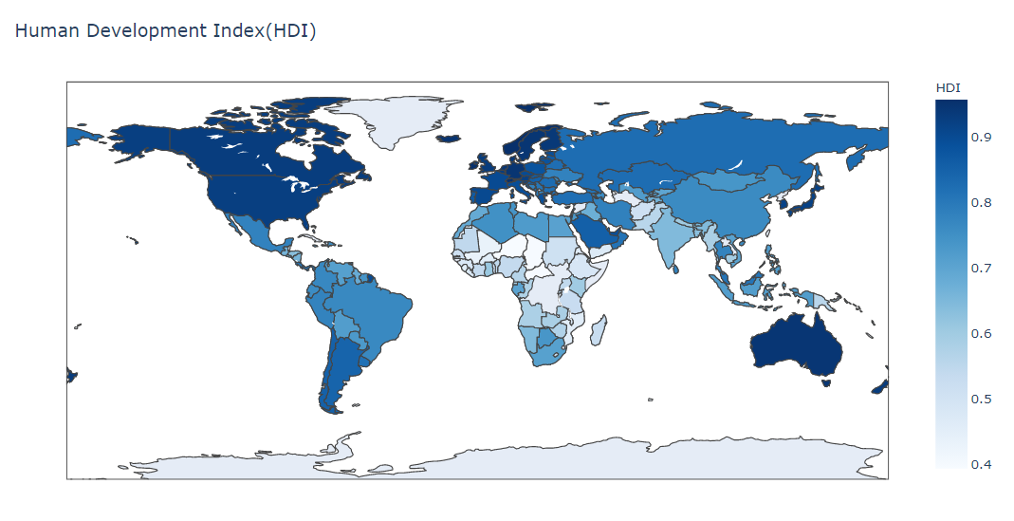
Global Data Fun to look at, difficult to interpret
We considered several independent variables but at the global level, the signal was lost in the noise.
We needed more granularity!

Slide 11
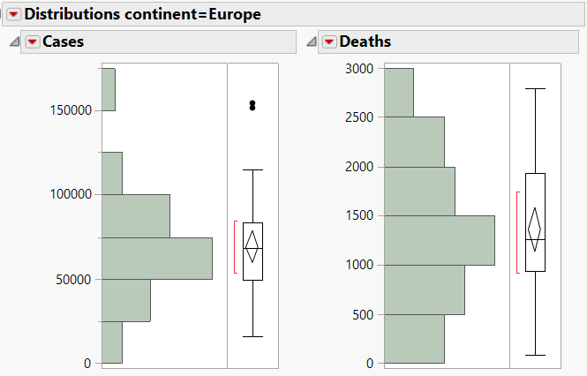

The Path Forward - Europe
Globally the relationships we looked at were weak and not enough to explain what might be going on
Europe had the most normal distribution of case and death data among all of the continents
This Photo by Unknown Author is licensed under CC BY-SA

Slide 12
Statistical Analysis
Drilling down into European Data

Slide 13
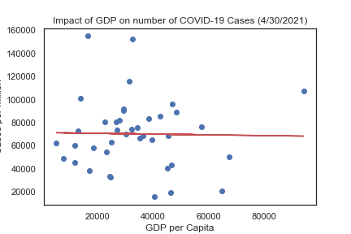
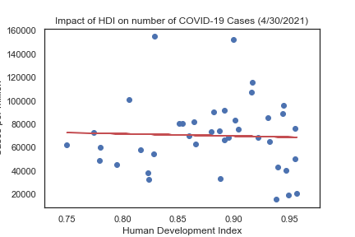
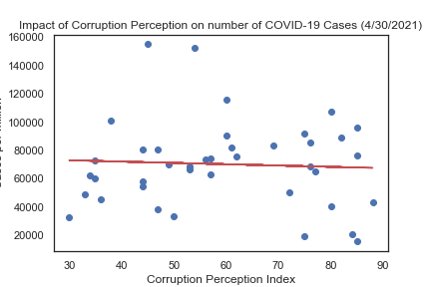
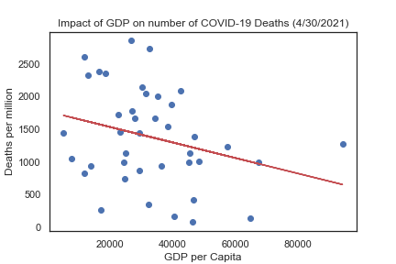
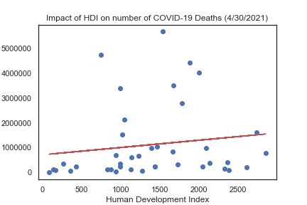
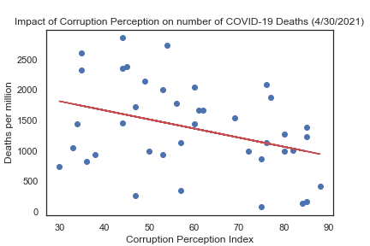
STILL A LOT OF NOTHING
Creating scatter plots to see the relationship between GDP, Human Development Index (HDI) and Corruption perception showed ups that there was little to no correlation between any of these metrics and Cases or Deaths per million.
r² = 0.0
r² = 0.0
r² = 0.0
r² = 0.08
r² = 0.02
r² = 0.13

Slide 14
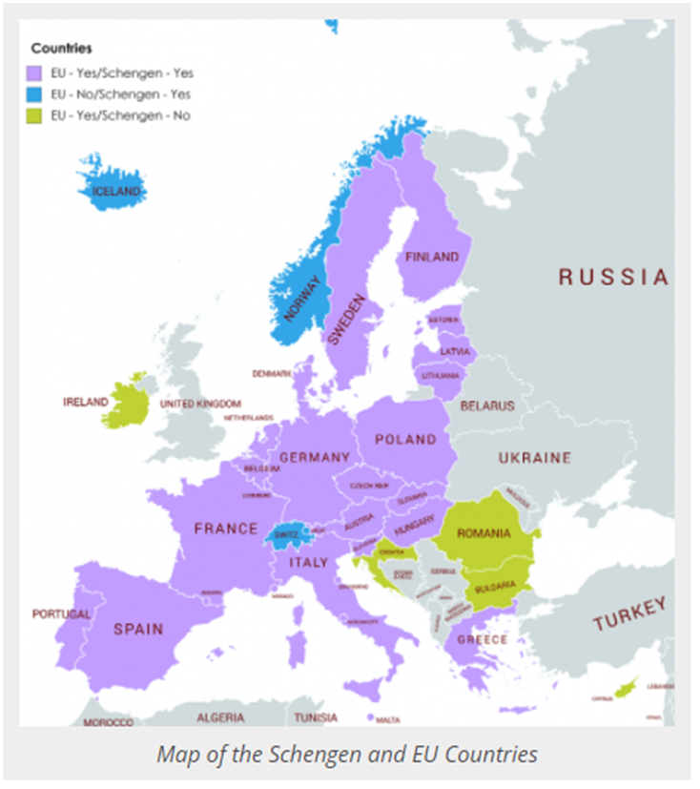
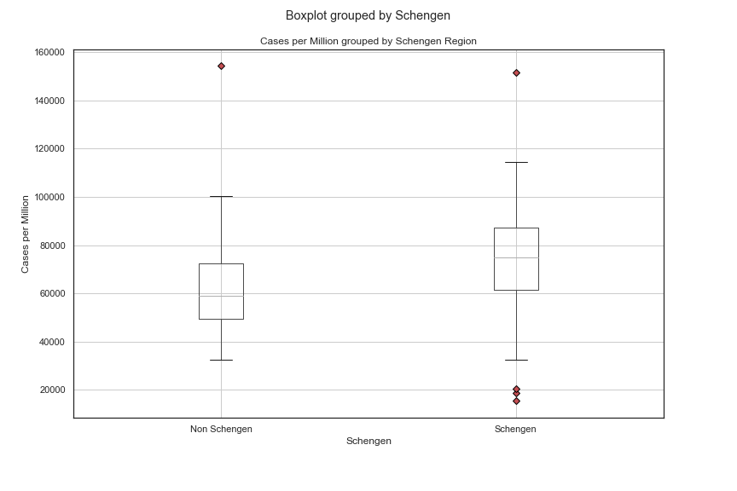
Schengen Region
We considered free movement as a factor, but…
P value = 0.516 (cannot reject the null hypothesis)

Slide 15
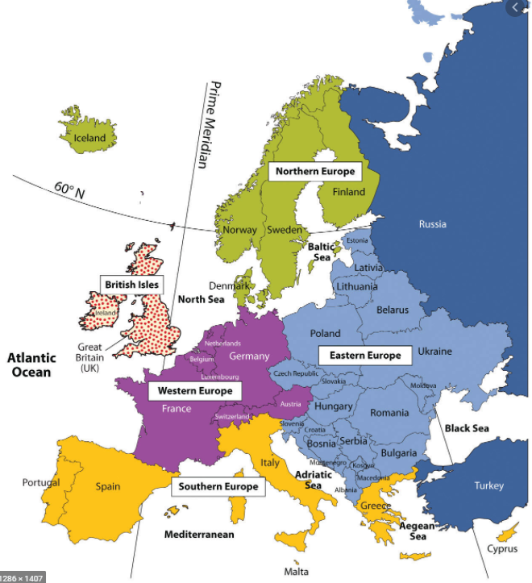
Euro-Regions Groups
We tried separating Europe into four regions
Don’t Russian to judgment!
We included Russia in the European dataset, despite the fact that it is trans-continental

Slide 16
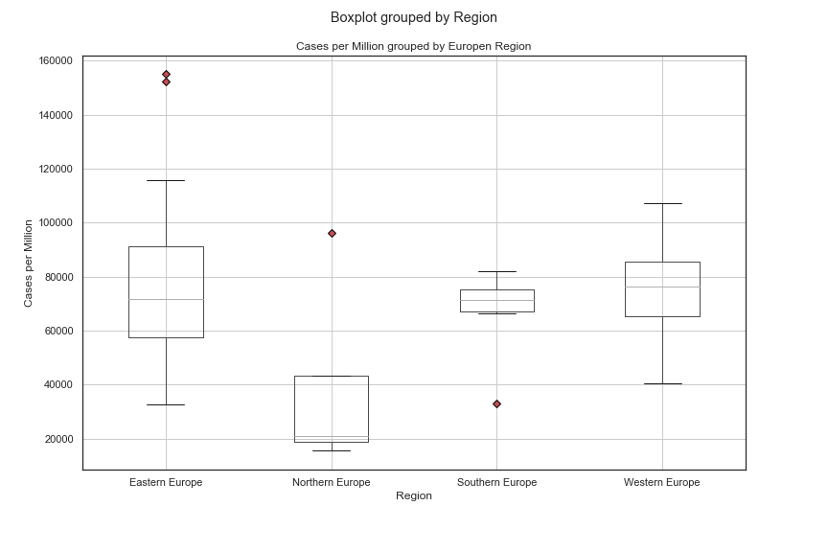
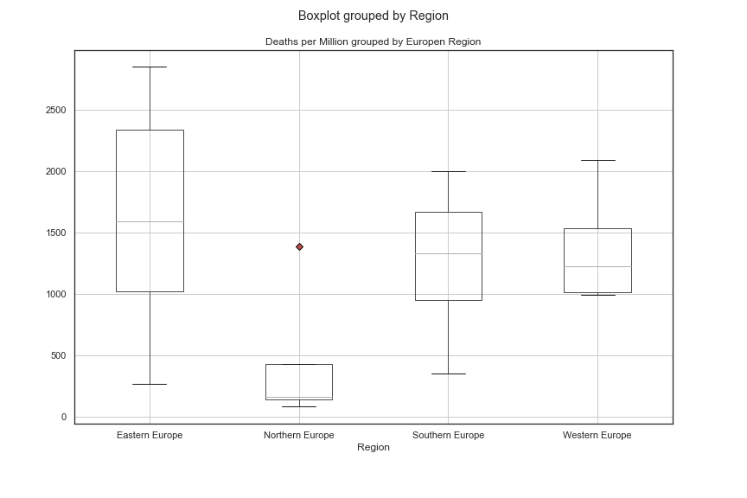
Stacking Up the Boxes
Czechia
Montenegro
Sweden
Sweden
Greece
By simply charting a boxplot of the different regions, we could see that Northern Europe looked different enough from the other three regions to be worth investigating.

Slide 17
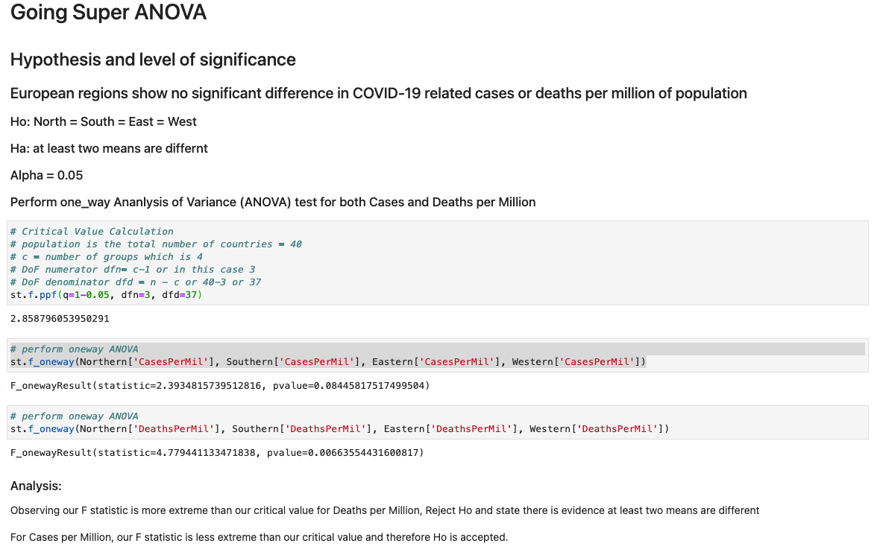

ANOVA Testing
For Cases per Million, H₀ was accepted with a p-value of 0.0845 against an Alpha of 0.05
For Deaths per Million H₀ was rejected with a p-value of 0.0066 against an Alpha of 0.05
If you remove Sweden from the data due to the failure* of their plan to use common sense rather than restrictions, p-values are 0.01236 and 0.00215 for Cases and Deaths respectively.
* https://www.bbc.com/news/world-europe-55347021

Slide 18
T-Tests by Region
Cases per Million
Region | Northern | Southern | Eastern
Southern | 0.17456
Eastern | 0.09409 | 0.45341
Western | 0.04081 | 0.63630 | 0.15506
The ANOVA test showed that there were differences in at least one region for Deaths per Million, but we were curious exactly which region or regions were different.
For Cases per Million, the only combination with p-value less than 0.05 was Northern Europe vs Western Europe.
For Deaths per Million, Northern Europe had p-values less than 0.05 for both Eastern and Western Europe.
Deaths per Million
Region | Northern | Southern | Eastern
Southern | 0.15572
Eastern | 0.02734 | 0.41709
Western | 0.04365 | 0.85791 | 0.20632

Slide 19

Conclusions (are we Finnish yet?)
In terms of cases & deaths, countries are probably different from one another!
Intuitively, it makes sense that Northern Europe is different from other regions
We were surprised that Eastern Europe wasn’t different
In general, geopolitical measures such as GDP, population density and HDI seemed to have low measurability on COVID case or death outcomes

Slide 20

Suggestions for Future Research
Do we trust the data? – Identify biases in reporting
Need more granularity in datasets
Percent positivity would be great
Tests per capita by county would be great
Look at vaccines - more data needed
This Photo by Unknown Author is licensed under CC BY-NC

Slide 21
Works Cited
Marsja, Erik. “Four Ways to Conduct One-Way ANOVA with Python.” Erik Marsja, 19 Nov. 2020,
“2020 - CPI.” Transparency.org, www.transparency.org/en/cpi/2020.
“Schengen Countries: Visa Information for Schengen Area.” ETIAS Visa Waiver for Europe, www.etiasvisa.com/schengen-visa/countries.
Regions of Western Europe, saylordotorg.github.io/text_world-regional-geography-people-places-and-globalization/s05-04-regions-of-western-europe.html.
Standard Of Living By Country 2021, worldpopulationreview.com/country-rankings/standard-of-living-by-country.
“Boxplot : Outliers Labels Python.” Edited by Andrea Blengino 4, Stack Overflow, 7 Nov. 2016, 16:41, stackoverflow.com/questions/40470175/boxplot-outliers-labels-python.
Mooney, Paul. “Latitude and Longitude for Every Country and State.” Kaggle, 13 Mar. 2020, www.kaggle.com/paultimothymooney/latitude-and-longitude-for-every-country-and-state.

